Slide 1

Communication, Training & Development
Dr. Emily Tarr

Slide 2
Human Capital Flow
What work needs done?
Designing motivating jobs
Acquiring the right human capital
Ensuring that human capital is equipped to do their jobs well
Assessing role performance
Providing reinforcement

Slide 3
Role Perceptions
Understanding the job duties (roles) assigned to or expected of us
Greater role clarity exists when one understands:
Tasks or accountable consequences
Task/performance priorities
Preferred behaviors/procedures
Benefits of role clarity:
Better job performance
Better coordination with others
Higher motivation

Slide 4

Communication
The process by which information is transmitted and understood between two or more people

Slide 5
A Model of Communication
Sender
Receiver
Form Message
Encode Message
Receive
Encoded Message
Decode Message
Noise
Decode Feedback
Receive encoded feedback
Encode Feedback
Form Feedback

Slide 6

Group Discussion
Why is quality communication in organizations important?
Consider the statement: “Being a good communicator is finically beneficial for an organization.”
Do you agree with this statement? If so, explain your reasoning. If not, why not?

Slide 7
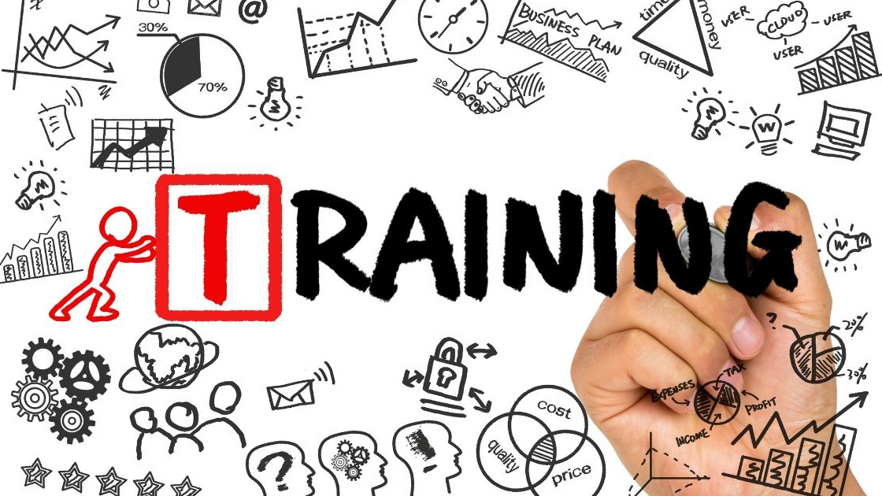
Think about a training you have been a part of. Discuss with a partner:
Was the training effective? Why or why not?

Slide 8
Training
An organization’s planned efforts to help employees acquire job-related knowledge, skills, abilities, and behaviors, with the goal of applying them on the job
Assess needs for training
Ensure readiness for training
Plan training program
Implement training program
Evaluate results of training

Slide 9

Designing a Training Program
Instructional design: a process of systematically developing training to meet specified needs

Slide 10
Step 1: Needs Assessment
Needs assessment: the process of evaluating the organization, individual employees, and employees’ tasks to determine what kinds of training, if any, are necessary
Organization analysis: What is the context in which training will occur?
Person analysis: Who needs training?
Task analysis: What subjects should the training cover?

Slide 11
Step 2:Ensure Readiness for Training
Employee readiness characteristics
Basic learning skills, especially cognitive ability
High motivation to learn
Work environment
Believe they are able to learn
See potential benefits
Aware of need to learn
See a fit between training and career goals
Have basic skills necessary for participation in training
Situational constraints: limits on training's effectiveness that arise from the situation or conditions in the organization
Social support: the ways the organization's people encourage training

Slide 12
Step 3: Plan The Training Program
Effective training objectives:
Include a statement of what the employee is expected to do, the quality or level of performance that is acceptable, and the conditions under which the employee is to apply what he or she learned
Include performance standards that are measurable
Identify the resources needed to carry about the desired performance or outcome

Slide 13
Step 3: Who Will Design the Program?
In-House
Cheaper (likely)
Will be more specified to the organization, including job titles, work tasks, and jargon
Requires specialized knowledge of how to put together training programs
Contracted Out
Can be extremely expensive
Do not need to dedicate in-house time to the efforts
Still requires an in-house person to coordinate the program

Slide 14

Learning is Promoted When:
Learners are engaged in solving real-world problems
Existing knowledge is activated as a foundation for new knowledge
New knowledge is demonstrated to the learner
New knowledge is applied by the learner
New knowledge is integrated into the learner’s lives

Slide 15
Training Design Considerations
Sequencing of information to be learned
Part learning (Microlearning) vs. whole learning
Opportunities to practice
Overlearning
Transfer-of-training
Observation/ Interaction

Slide 16
What Trainers Should Do:
Tell
Tell learners what they need to know
Demonstrate
Demonstrate the skill
Invite
Invite learner participation
Encourage
Encourage learners as they practice the new skill
Correct
Gently correct learners when they need guidance

Slide 17

Step 4: Implement
End goal = Transfer of Training
On-the-job use of knowledge, skills, and behaviors learned in training
Requires that employees actually learn the content of the training program
Requires that employees apply what they learned

Slide 18
Step 5: Evaluate the Results
Trainee satisfaction
Transfer of training
New skills, knowledge
Performance improvements
Return on investment

Slide 19

Development
Employee development: the combination of formal education, job experiences, relationships, and assessment of personality and abilities to help employees prepare for the future of their careers
Identifying high-potential employees
Making sure the organization uses the talents of these people
Reassuring them of their value

Slide 20

You are a manager of a team of 15-20 people. You have identified 2 of your employees as particularly high performing. They are so effective that you are anxious they may get poached to another company. Your goal is to retain them.
What do you do?

Slide 21
Approaches to Development
Formal education
Assessment
Job experiences
Interpersonal relationships
Executive education
Lectures
Short courses from consultants
Workshops designed specifically for the organization
Personality assessments
DiSC assessment
Performance appraisals
360-degree feedback
Occur when skills and experiences do not entirely match the skills requires for the current job
Job enlargement, job rotation
Transfer, downward move, promotion
Temporary assignments/sabbaticals
Mentoring: an experienced, productive senior employee who helps develop a less experienced employee
Coaching: a peer or manager who works with an employee to motivate him/her, help develop skills, and provide reinforcement and feedback

